Slide 1


KBTU
Neural
Network Visualization
september, 2022
December, 2022
Bakyt Kurmanov

Slide 2



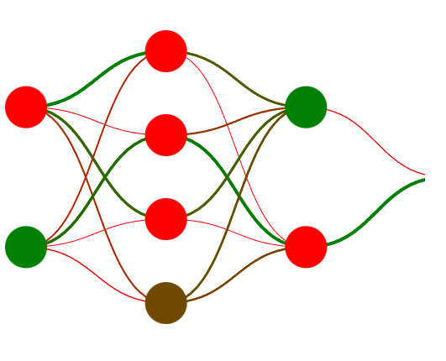

Project mockup
Animated:
“Axons”
Input and output layers
Hidden layers
№
2

Slide 3
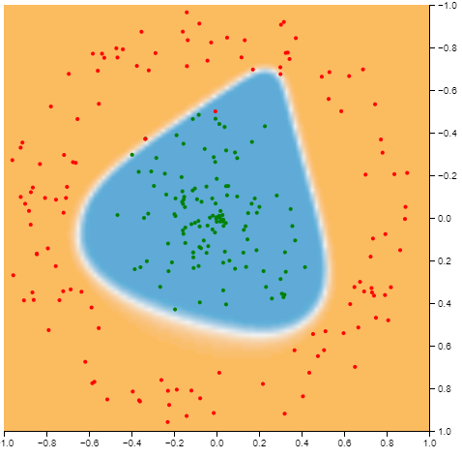
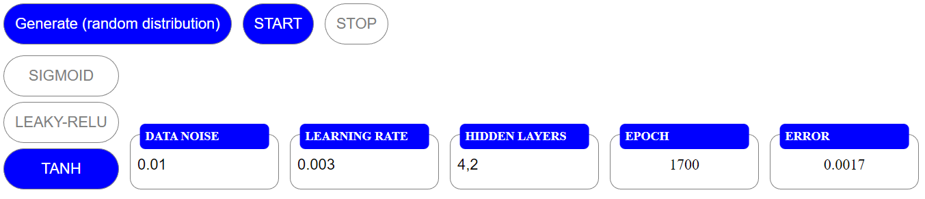
Visualization of neural network model
№
Animated “dots” classification process
Simple dashboard and controls
3

